Slide 1


Pharma Data Analysis
By Venkatesh Polisetti

Slide 2
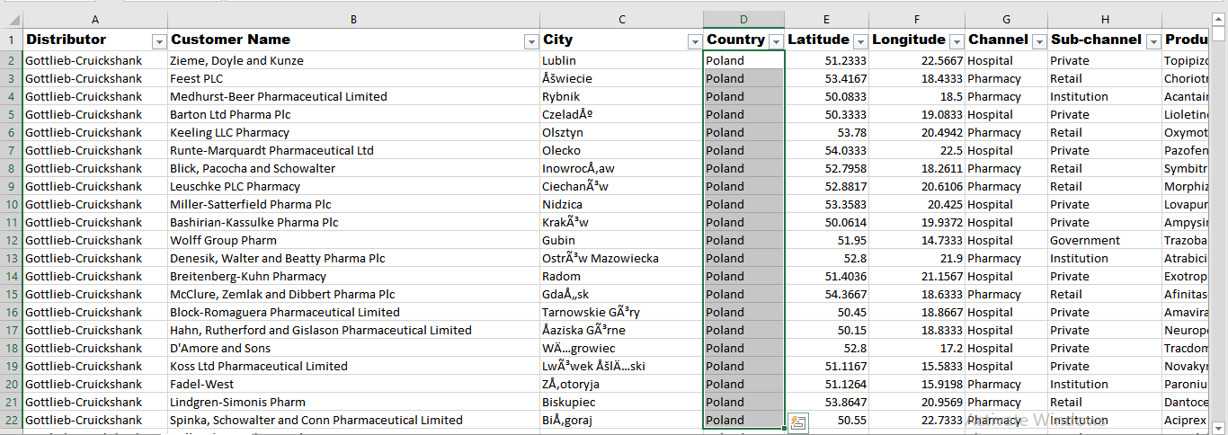
Basic Filtering: filter the data to show only the records for a specific country, let's say "Poland“.

Slide 3
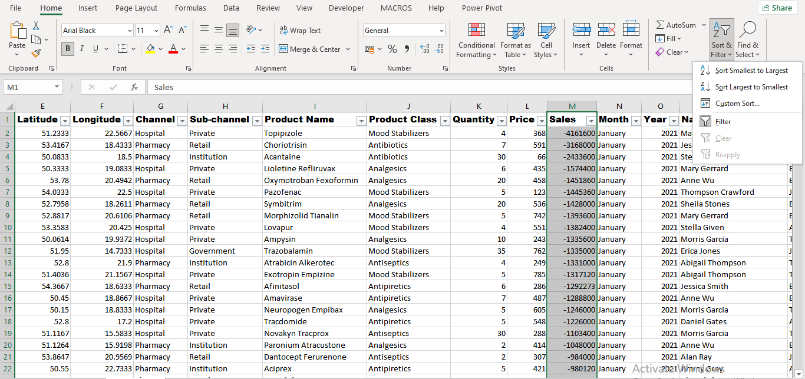
Sorting Data: Sort the data in ascending order based on the "Sales" column.

Slide 4
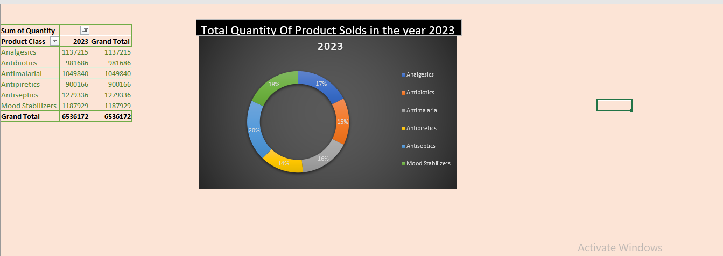
Summarizing Data: The total quantity of all products sold in the year 2023.

Slide 5
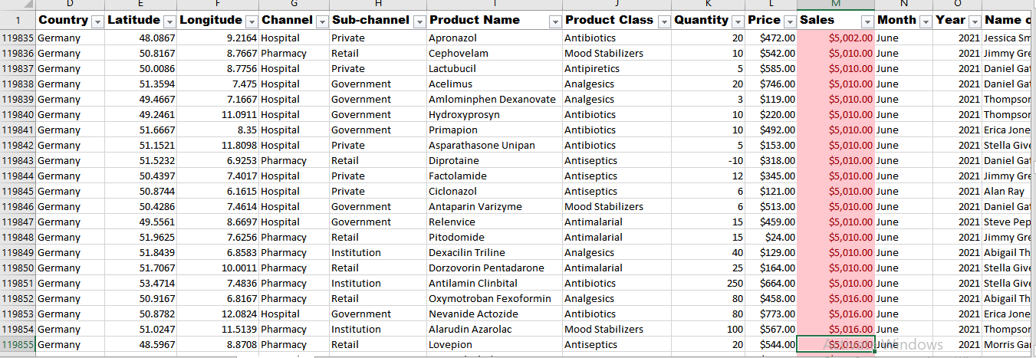
Conditional Formatting: conditional formatting to highlight all sales greater than $5,000 in the "Sales“ column.

Slide 6
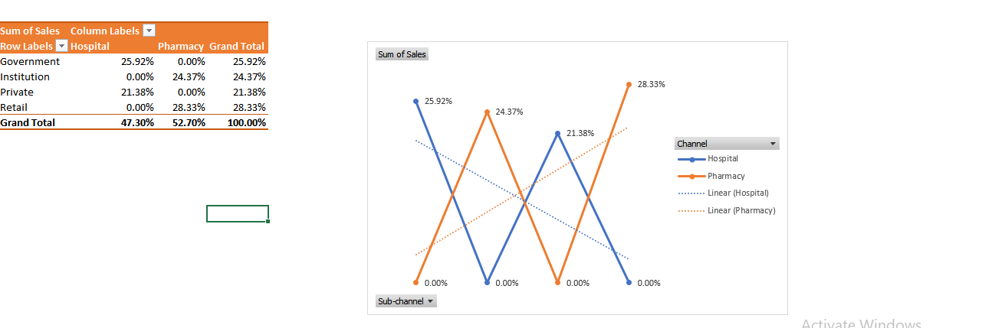
Simple Pivot Table: A pivot table to summarize total sales by "Channel."

Slide 7
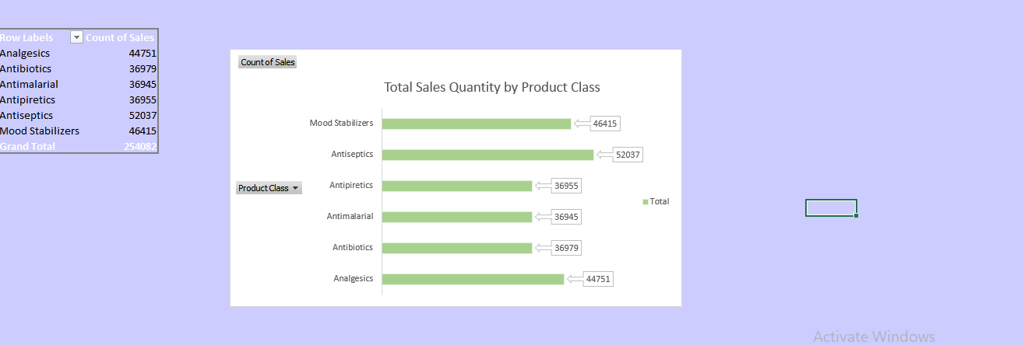
Basic Chart: A bar chart to visualize the sales quantity by "Product Class."

Slide 8
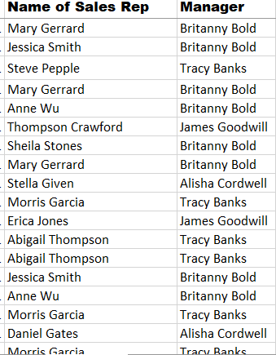
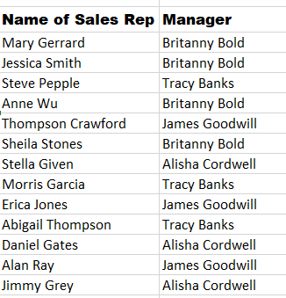
VLOOKUP Function: Using VLOOKUP function to find the "Manager" for a specific "Sales Rep“.
By Using vlookup we get required value

Slide 9
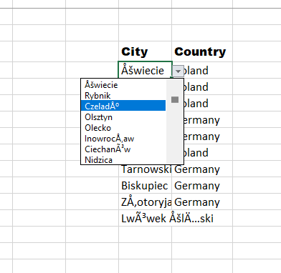
Data Validation : data validation to allow only specific cities from a predefined list in the "City" column.

Slide 10
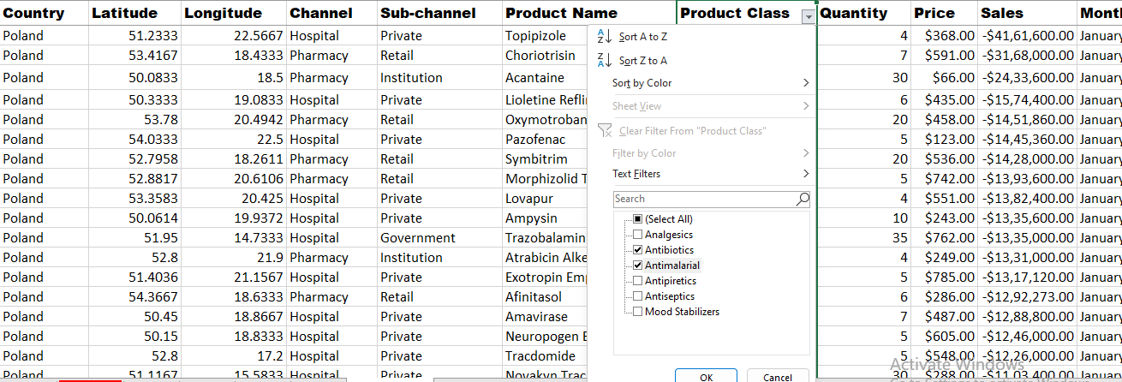
Advanced Filtering: Filter to show records where "Product Class" is either “Antibiotics" or “Antimalarial."

Slide 11
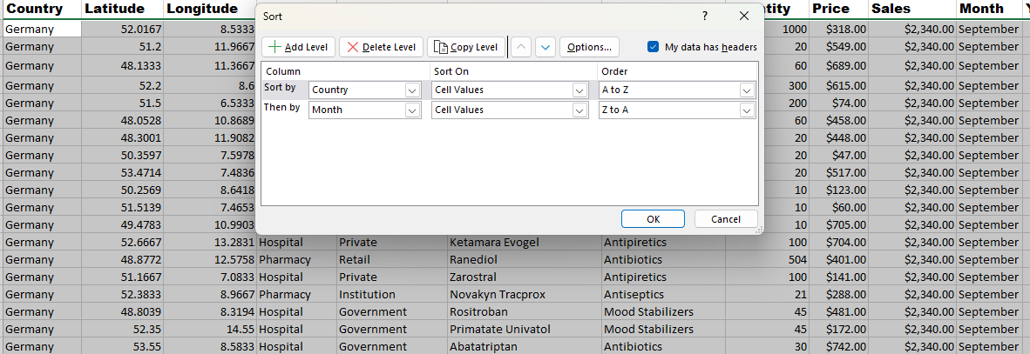
Sorting with Multiple Criteria: How would you sort the data first by "Country" in ascending order, and then by "Month" in descending order?

Slide 12
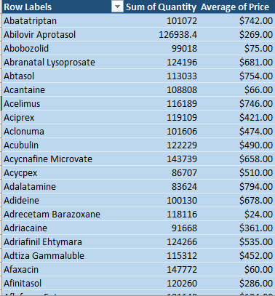
Calculated Fields in Pivot Table: calculated field in the pivot table to calculate the average price per unit sold.

Slide 13
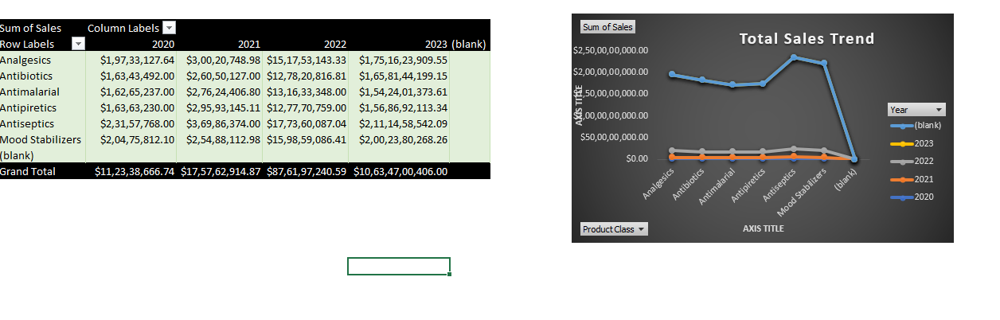
Advanced Charting: A line chart to show the trend of total sales over the years.

Slide 14
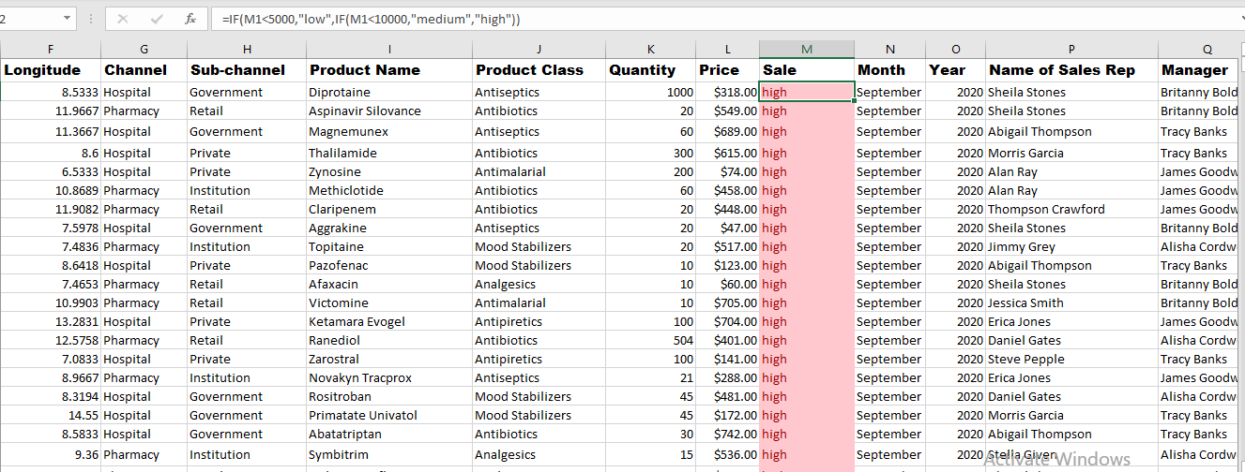
Nested IF Function: nested IF function to categorize "Sales" into three categories: Low, Medium, and High.

Slide 15
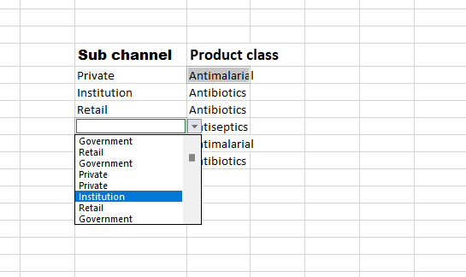
Data Validation with Dropdown Lists: Create dropdown lists for "Product Class" and "Sub-channel" in the data entry cells.

Slide 16
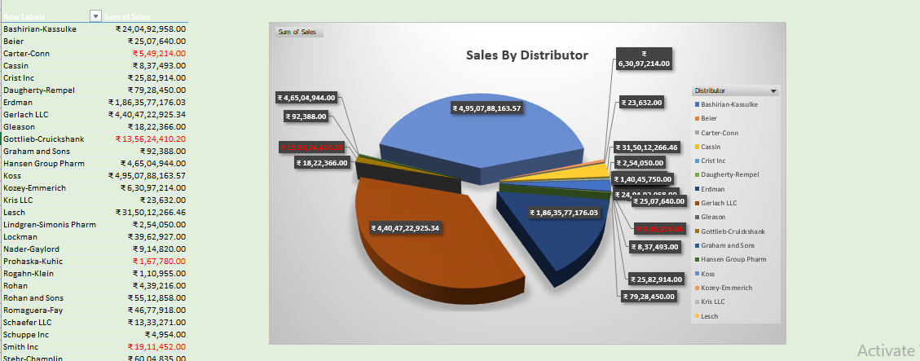
Pivot Chart: pivot table created earlier into a pivot chart to visualize sales by "Distributor."

Slide 17
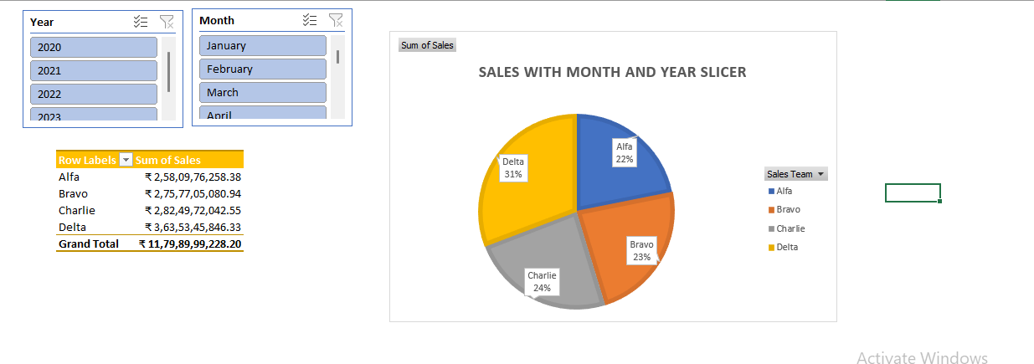
Pivot Table Slicers: Add slicers to the pivot table to allow easy filtering by "Month" and "Year."

Slide 18
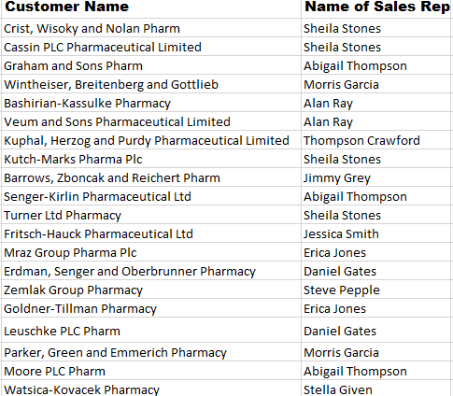
Lookup Functions: Use INDEX and MATCH functions to find the "Sales Rep" for a specific "Customer Name."

Slide 19
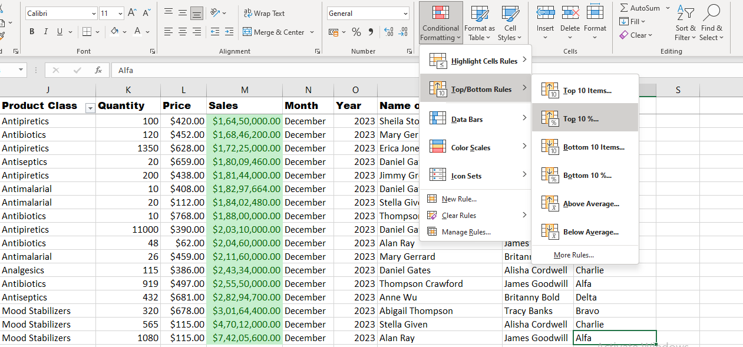
Advanced Conditional Formatting: Conditional format to highlight the top 10% of sales values with a distinct colour.

Slide 20
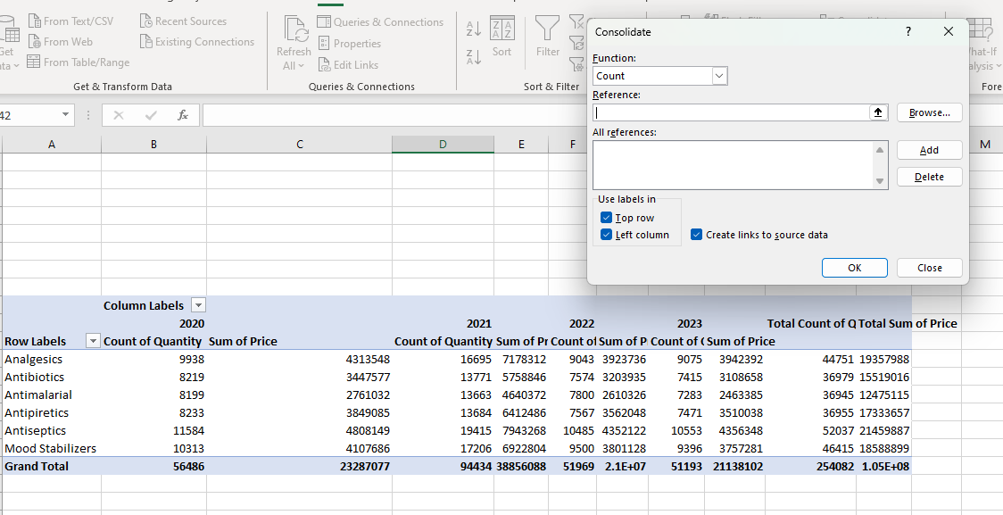
Data Consolidation: Consolidate data from multiple files into a single master file and create a pivot table to summarize the combined data.

Slide 21
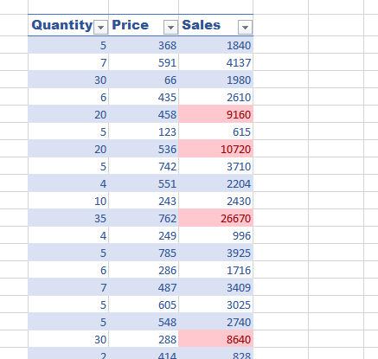
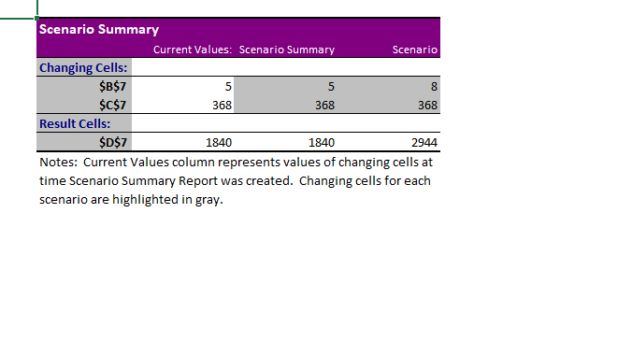
Scenario Manager: Scenario Manager to compare different scenarios for future sales by changing variables like "Price" and "Quantity."

Slide 22


